Slide 1
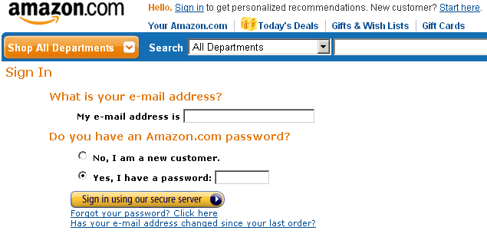
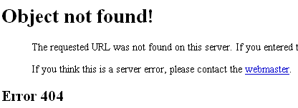
One large website. Complex.
One small software upgrade. Easy.
One 90 minute outage. Priceless?
No! It was estimated to cost $2.8M in lost revenue.
This is not safety-critical, but it is financial-critical.
This team needed a better understanding of the process for developing a critical system, and how to bring an upgrade on-line without taking down the system.
Software development process

Slide 2
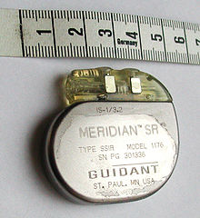
Let’s think about a process question.
What should be the differences in the way a team approaches developing the following systems?

Slide 3
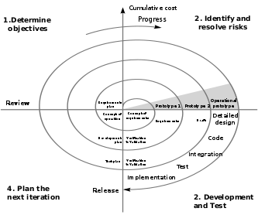
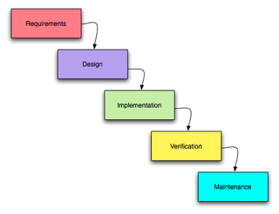
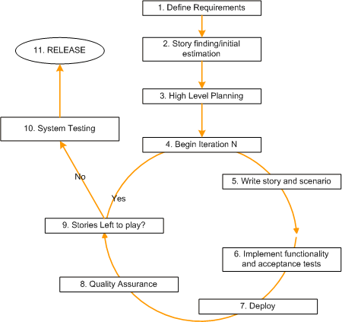
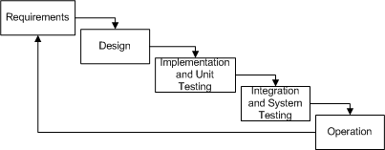
Software engineers need to understand the best development methods for creating quality software.

